Slide 1
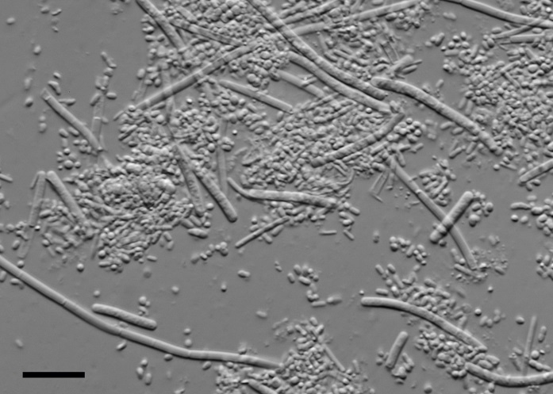
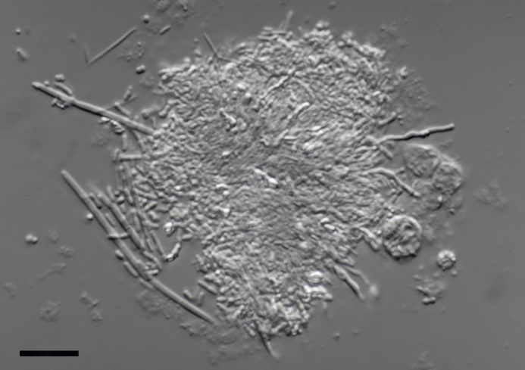
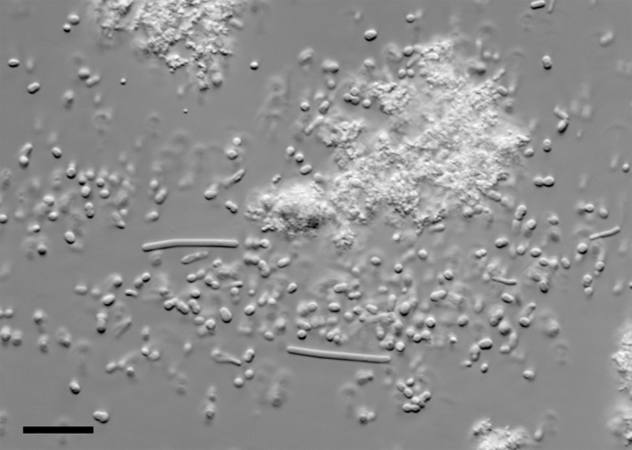
A
Differential interference contrast micrographs of samples from (A) the dorsal surface of the tongue, (B) saliva and (C) the probiotic yoghurt drink. The bar indicates a length of 10 µm.
B
C

